Slide 1

Ad-Hoc Insights
Consumer goods
Presented by : Niharika Kanjariya

Slide 2
Content
1. Company Overview 2. Problem statement 3. Ad-hoc requests , Query, output and insights 4. Recommendations

Slide 3
Company Overview
AtliQ Hardwares (imaginary company) is one of the leading computer hardware producers in India and well expanded in other countries too.

Slide 4
Problem Statement
The management of AtliQ hardware noticed that they do not get enough insights to make quick and smart data-informed decisions. They want to expand their data analytics team by adding several junior data analysts. Tony Sharma, their data analytics director wanted to hire someone who is good at both tech and soft skills. Hence, he decided to conduct a SQL challenge which will help him understand both the skills.

Slide 5
Ad-hoc requests , output and insights
Requests 1. Provide the list of markets in which customer "AtliQ Exclusive" operates its business in the APAC region.
Query
select distinct market from dim_customer where customer = "AtliQ exclusive“ and region = "APAC“;

Slide 6
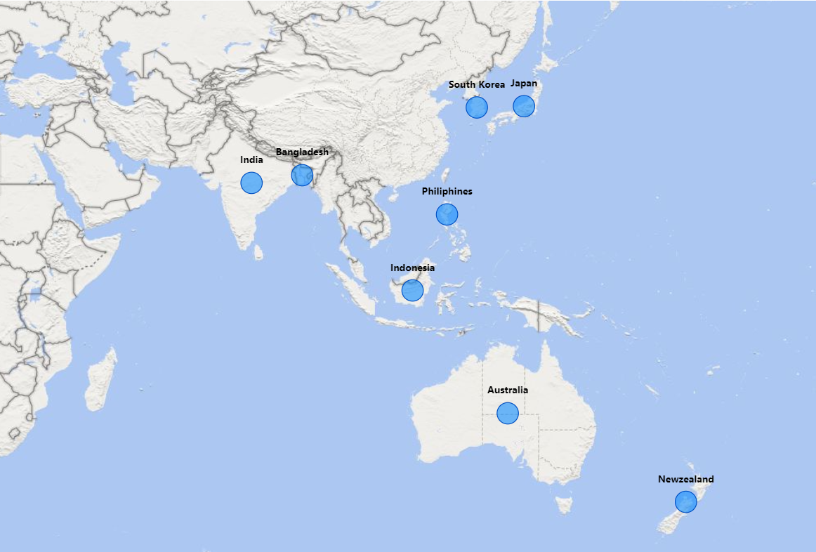
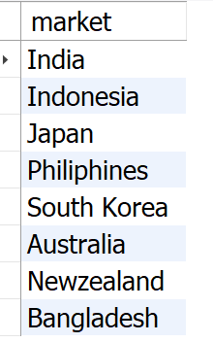
Output
Insight
AtliQ Exclusive operates in eight countries within the APAC region, demonstrating a significant regional market presence.

Slide 7
What is the percentage of unique product increase in 2021 vs. 2020? The final output contains these fields, unique_products_2020, unique_products_2021, percentage_chg .
Requests 2.
Query
with cte1 as ( select count(distinct product_code) as unique_product_2020 from fact_sales_monthly where fiscal_year = 2020 ), cte2 as ( select count(distinct product_code) as unique_product_2021 from fact_sales_monthly where fiscal_year = 2021 ) select unique_product_2020, unique_product_2021, (unique_product_2021-unique_product_2020)*100/unique_product_2020 as pct_change from cte1 cross join cte2;

Slide 8
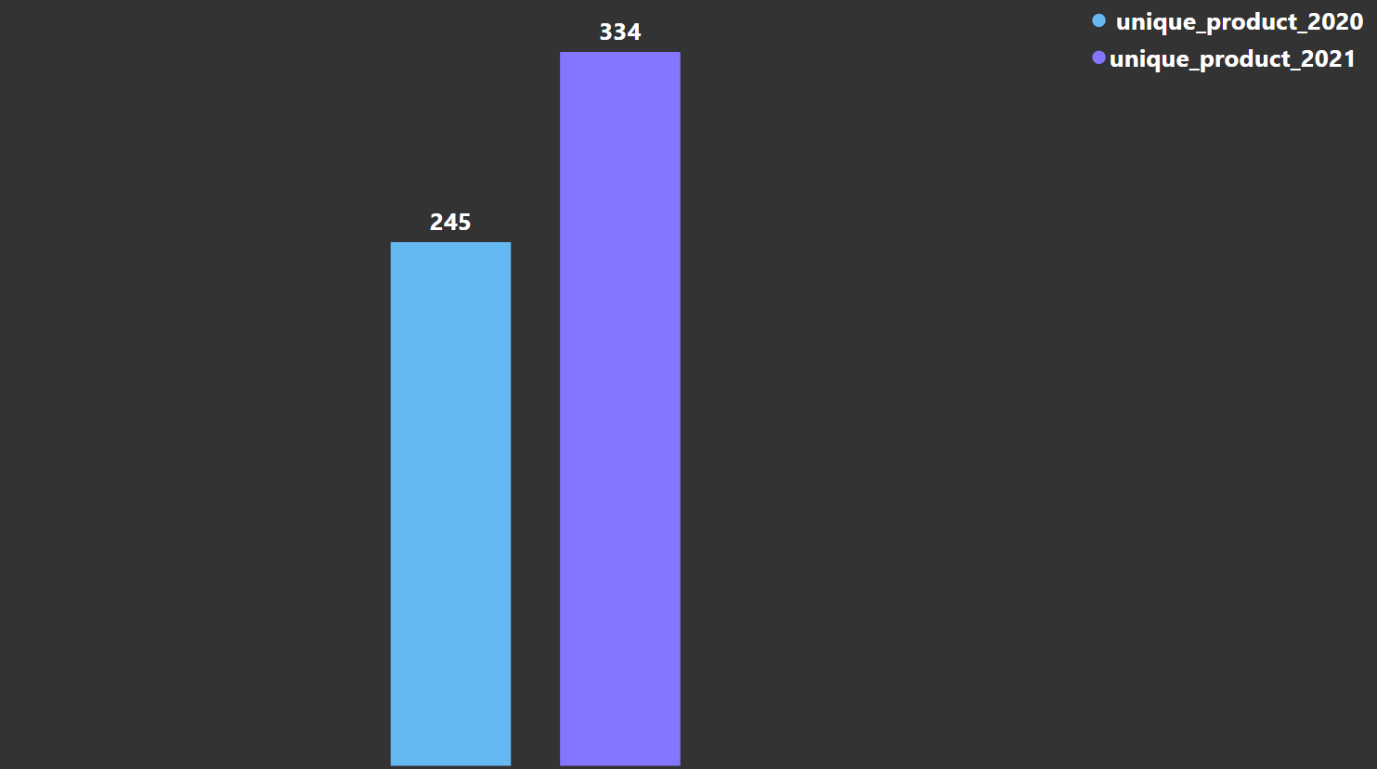
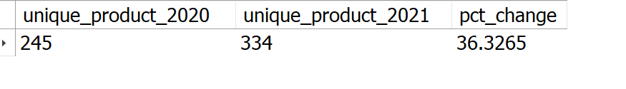
Output
36.33%
Insights
The number of unique products grew from 245 in 2020 to 334 in 2021, marking a 36.33% increase.

Slide 9
Requests 3.
Provide a report with all the unique product counts for each segment and sort them in descending order of product counts. The final output contains 2 fields, segment, product_count.
Query
select segment, count(distinct product_code) as Product_count from dim_product group by segment order by Product_count desc;

Slide 10
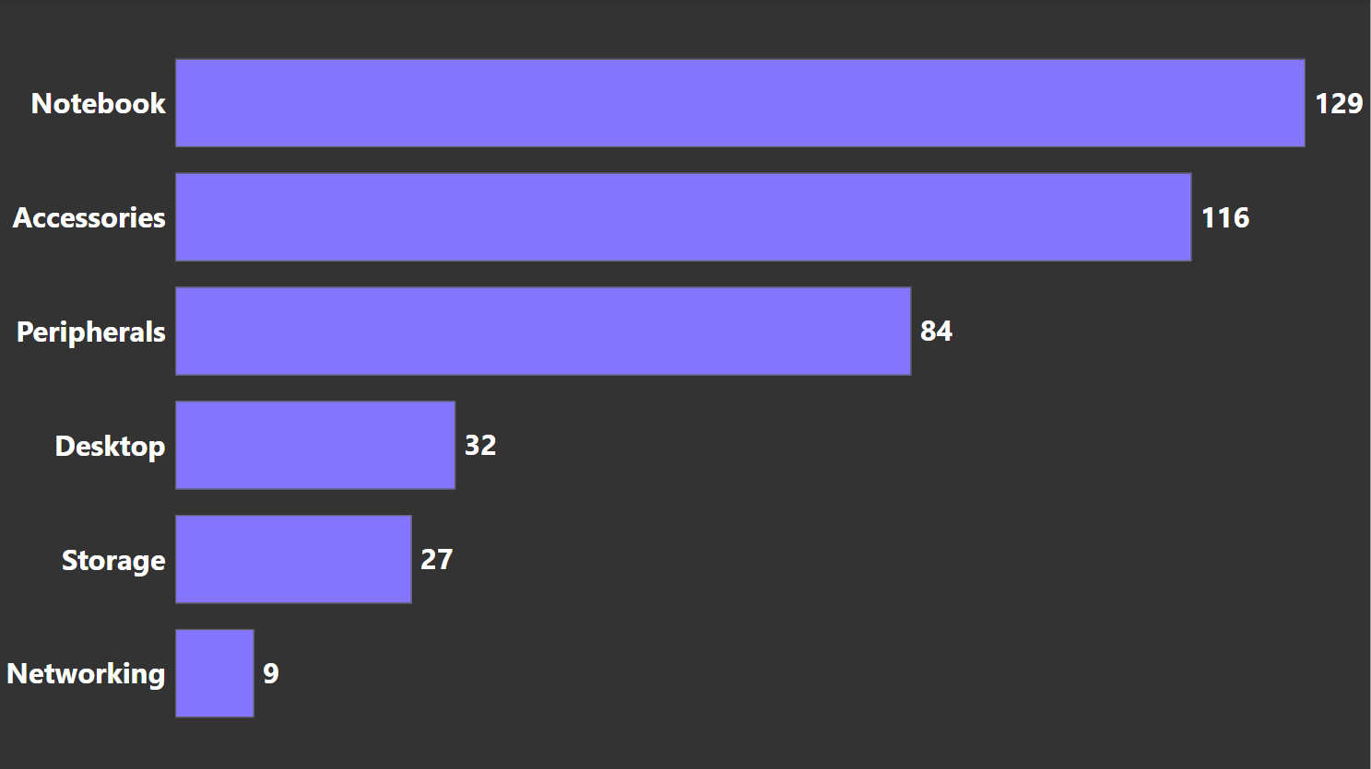
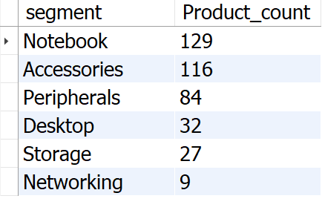
Output
1. AtliQ dominates the Notebooks, Accessories, and Peripherals segment, making up an impressive 82.87% of its product range. 2. Desktops, Storage, and Networking constitute a smaller portion of AtliQ's portfolio, representing just 17.13%. 3. To strengthen its presence in the Desktops, Storage, and Networking category, AtliQ should prioritize products that align with evolving customer preferences and industry trends.
Insights

Slide 11
Requests 4.
Follow-up: Which segment had the most increase in unique products in 2021 vs 2020? The final output contains these fields, segment, product_count_2020, product_count_2021, difference.
with unique_products as( select p.segment, count(distinct(case when fiscal_year = 2020 then s.product_code end)) as product_count_2020, count(distinct(case when fiscal_year = 2021 then s.Product_code end)) as product_count_2021 from fact_sales_monthly s join dim_product p on s.product_code = p.product_code group by p.segment ) select *, product_count_2021-product_count_2020 as difference from unique_products order by difference desc;
Query

Slide 12
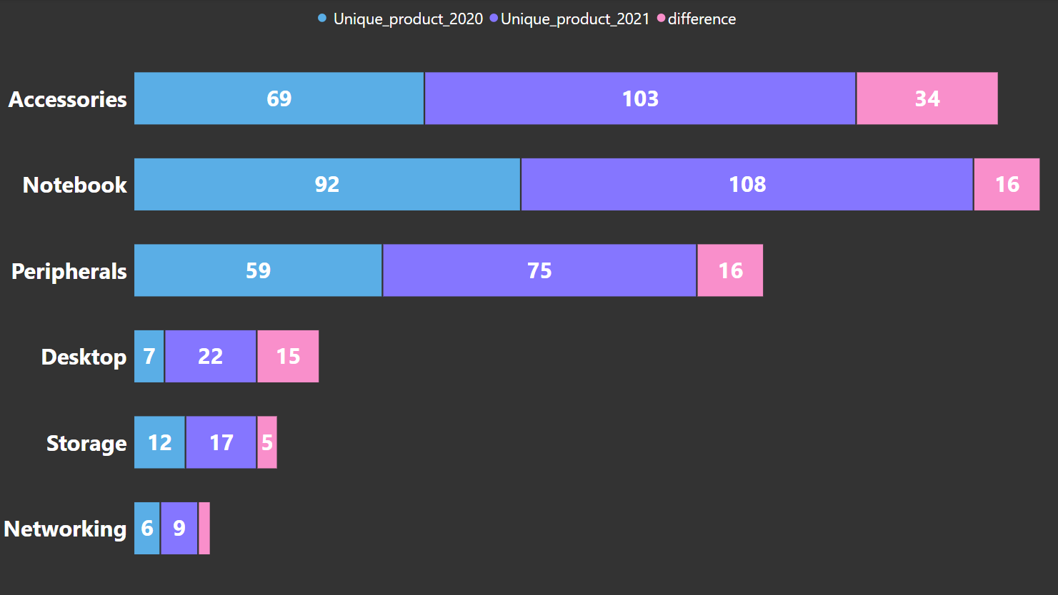
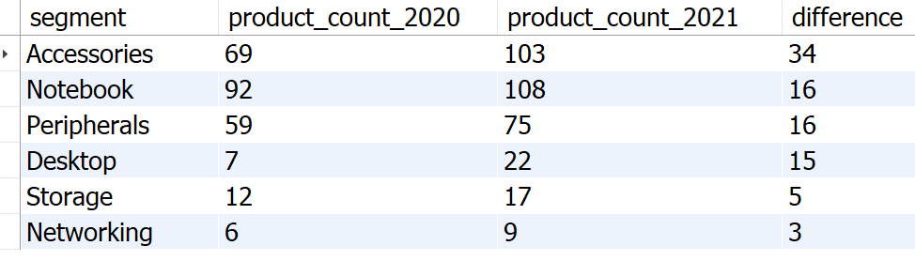
Output
Insights
For AtliQ hardware, Desktop segment saw highest comparative increase in its products in year 2021.

Slide 13
Requests 5.
Get the products that have the highest and lowest manufacturing costs. The final output should contain these fields, product_code ,product, manufacturing_cost .
Query
(select p.product_code, p.product, m.manufacturing_cost from dim_product p join fact_manufacturing_cost m on p.product_code = m.product_code order by m.manufacturing_cost desc limit 1) union (select p.product_code, p.product, m.manufacturing_cost from dim_product p join fact_manufacturing_cost m on p.product_code = m.product_code order by m.manufacturing_cost asc limit 1);

Slide 14
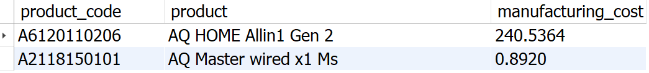


Output
Highest Manufacturing Cost Product
Lowest Manufacturing Cost Product
AQ Home Allin1 Gen2
AQ Master Wired X1 MS

Slide 15
Requests 6.
Generate a report which contains the top 5 customers who received an average high pre_invoice_discount_pct for the fiscal year 2021 and in the Indian market. The final output contains these fields, customer_code, customer, average_discount_percentage .
Query
with cte1 as( SELECT * from fact_pre_invoice_deductions join dim_customer c using (customer_code) where fiscal_year = 2021 and c. market = ‘india’ ) select customer_code, customer, concat(round(avg(pre_invoice_discount_pct)*100,2),"%") as avg_discount_pct from cte1 group by customer_code, customer order by avg(pre_invoice_discount_pct)*100 desc limit 5;

Slide 16
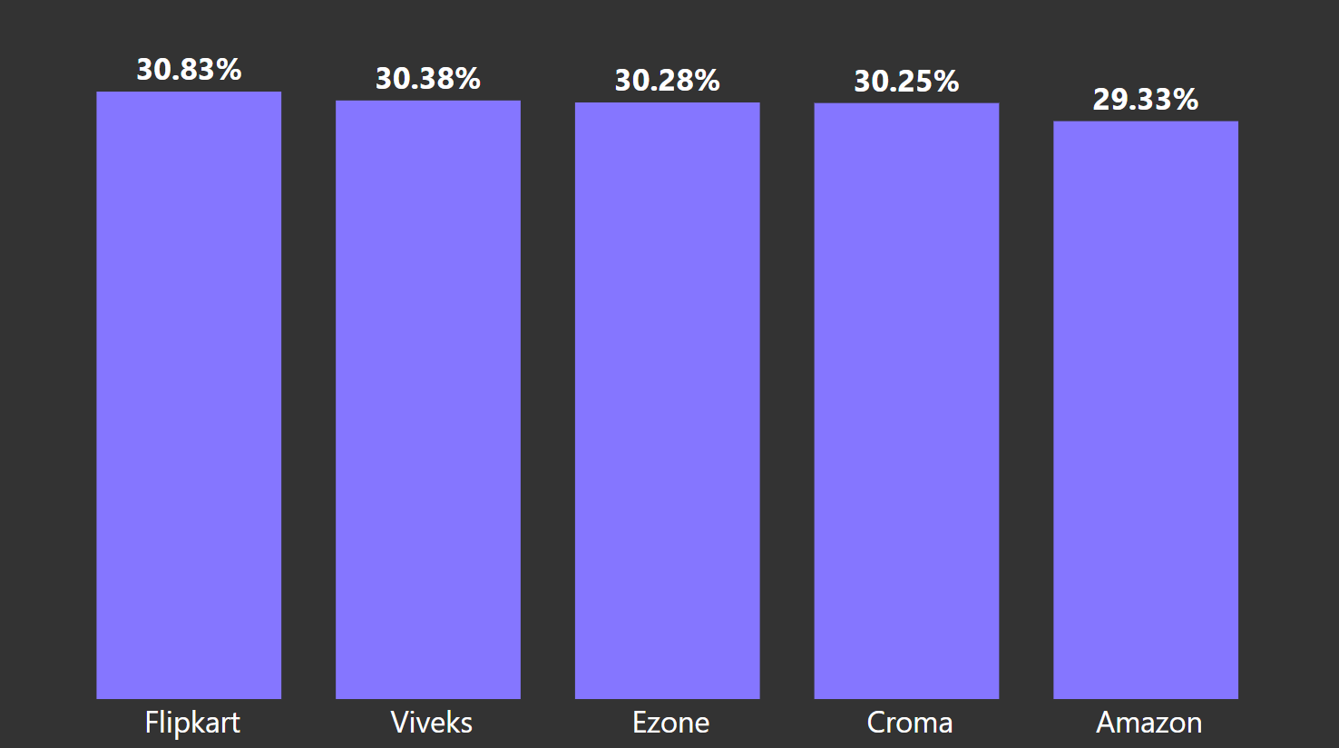
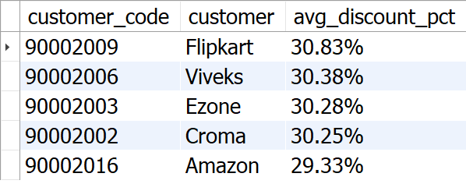
Output
1. Flipkart leads the list with the highest average discount percentage at 30.83%. 2. AtliQ has provided relatively uniform discount percentages to its top 5 customers, with a narrow range of discounts from 29.33% to 30.83%.
Insights

Slide 17
Requests 7.
Get the complete report of the Gross sales amount for the customer “AtliQ Exclusive” for each month. This analysis helps to get an idea of low and high-performing months and take strategic decisions. The final report contains these columns: Month, Year, Gross sales Amount.
Query
Select monthname(s.date) as Month , s.fiscal_year as Year, sum(sold_quantity*gross_price) as Gross_sales from fact_sales_monthly s join fact_gross_price g on s.product_code = g.product_code join dim_customer c on s.customer_code = c.customer_code where customer = "AtliQ Exclusive“ group by month,year order by year asc ;

Slide 18
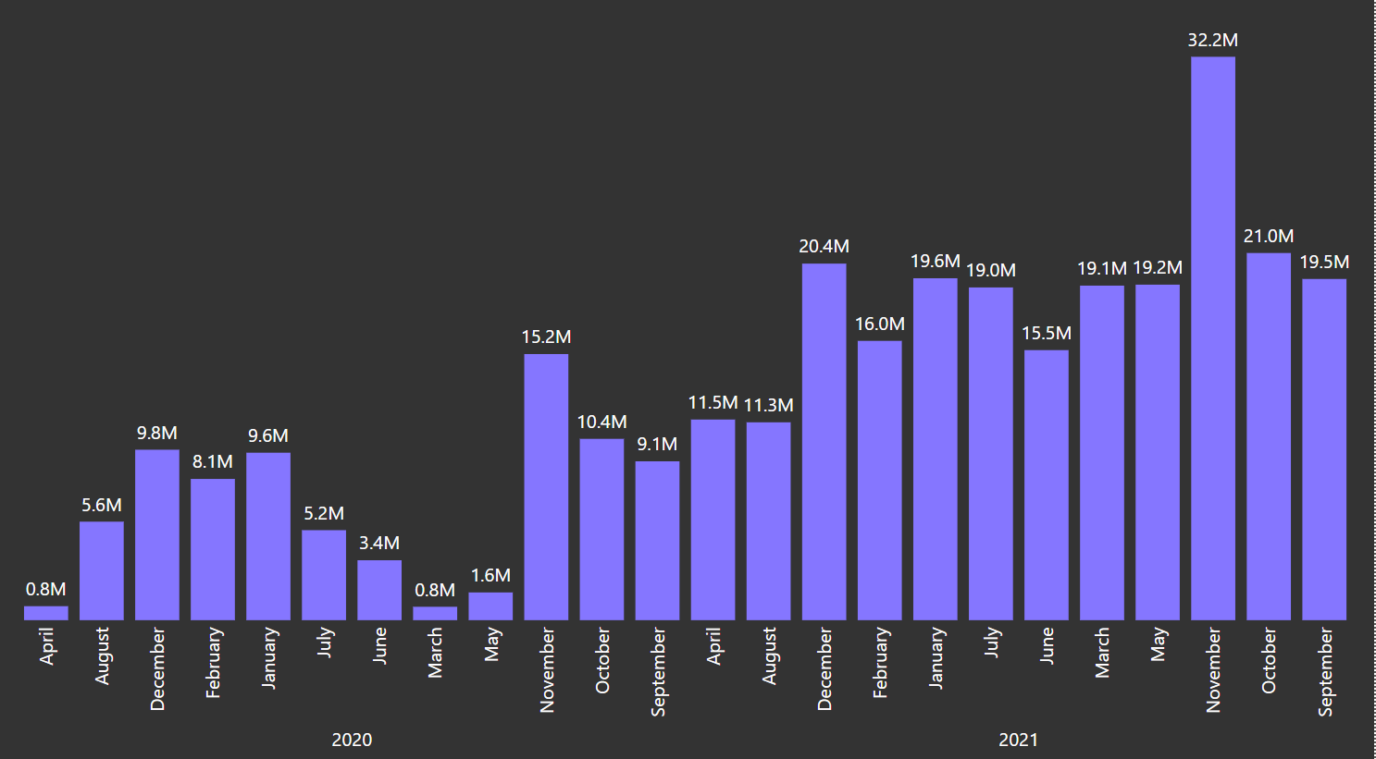
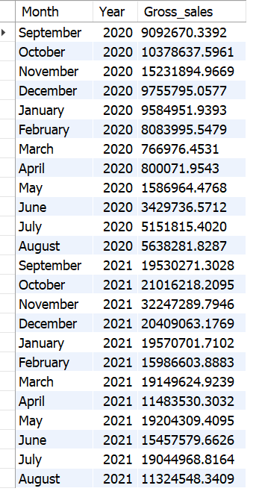
Output
1. Sales were at their lowest in March, April, and May 2020, likely impacted by the COVID-19 pandemic, but began recovering from June onward.
2. November 2020 saw the highest sales, reaching approximately 15.23 million.
3. Sales in 2021 showed remarkable growth compared to the previous year.
4. In 2021, August recorded the lowest sales at 11.32 million, while November saw the peak, reaching 32.25 million.
Insights

Slide 19
Requests 8.
In which quarter of 2020, got the maximum total_sold_quantity? The final output contains these fields sorted by the total_sold_quantity, Quarter, total_sold_quantity.
Query
select ( case when month(date) in (9, 10, 11) then "Q1" when month(date) in ( 12,1, 2) then "Q2" when month(date) in ( 3, 4, 5) then "Q3" when month (date) in (6,7,8) then "Q4" end) as Quarter, sum(sold_quantity) as total_sold_qty from fact_sales_monthly where fiscal_year = 2020 group by Quarter order by total_sold_qty desc ;

Slide 20
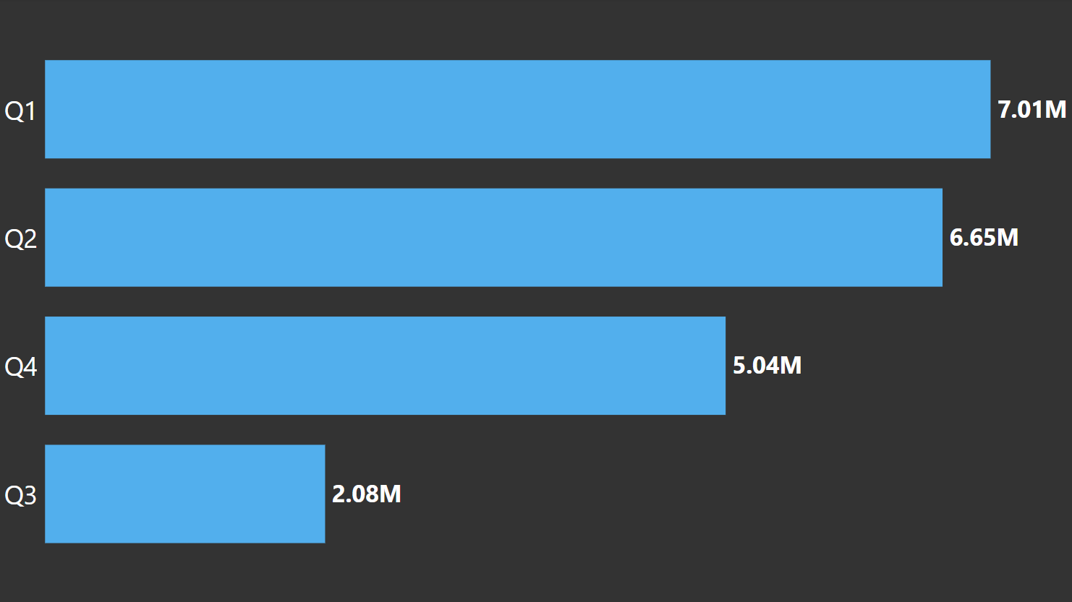
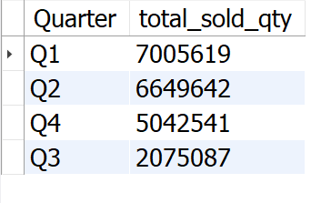
Output
For fiscal year 2020, Q3 was with the least products sold. In summer the computer hardware demand decreases and AtliQ Hardware can come up with some outdoor products like waterproof speakers to hike up the sales.
.
Insights

Slide 21
Requests 9.
Which channel helped to bring more gross sales in the fiscal year 2021 and the percentage of contribution? The final output contains these fields, channel, gross_sales_mln, percentage.
Query
with cte1 as ( select c.channel, round(sum((s.sold_quantity*g.gross_price)/1000000),2) as gross_sales_mln from dim_customer c join fact_sales_monthly s on c.customer_code = s.customer_code join fact_gross_price g on s.product_code = g.product_code where s.fiscal_year = 2021 group by c.channel ) select *, concat(round(gross_sales_mln*100/ (select sum(gross_sales_mln) from cte1),2)," %") as pct_contribution from cte1 order by pct_contribution desc;

Slide 22
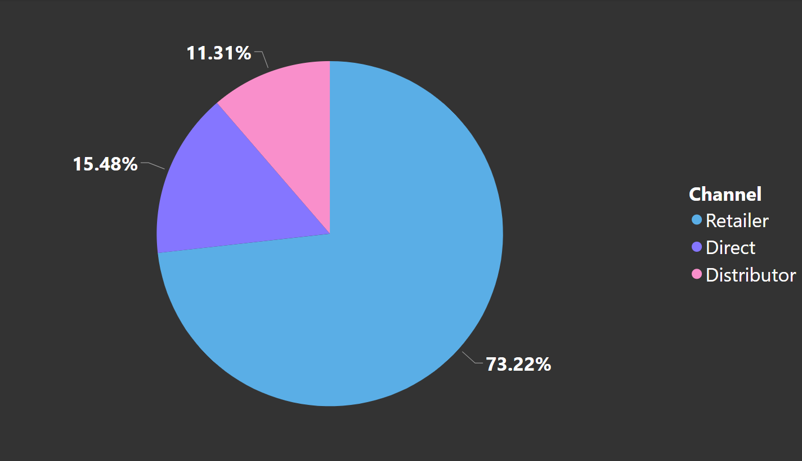
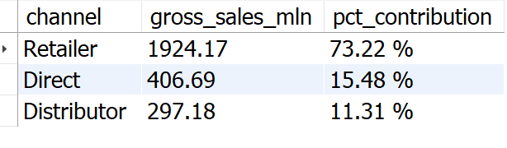
Output
1. The majority of AtliQ's sales come from retailers, accounting for a substantial 73.22% of the total gross sales. 2. Direct and distributor channel together contributes only 26.79% of the total sales.
Insights

Slide 23
Requests 10.
Get the Top 3 products in each division that have a high total_sold_quantity in the fiscal_year 2021? The final output contains these fields, division product_code product total_sold_quantity rank_order.
Query
with cte1 as( select p.division, s.product_code, concat(p.product," (", p.variant,")") as product, sum(s.sold_quantity) as total_sold_qty, rank() over(partition by p.division order by sum(s.sold_quantity) desc) as rank_order from dim_product p join fact_sales_monthly s on p.product_code = s.product_code where fiscal_year = 2021 group by p.division,s.product_code,p.product ) select * from cte1 where rank_order in (1,2,3) order by division, rank_order asc;

Slide 24
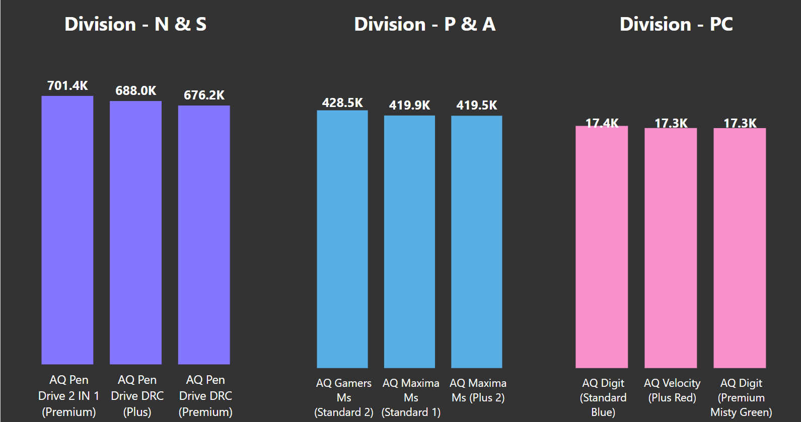
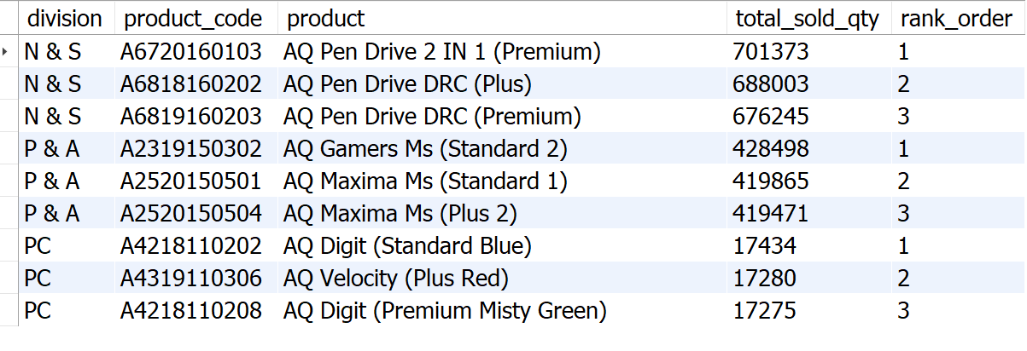
Output
1. In the N & S division, pen drives dominate the top three spots, showcasing their popularity and high sales performance. 2. The P & A division's top three products are exclusively mouse, reflecting a clear demand for these devices. 3. The PC division's bestsellers are all personal laptops.
Insights

Slide 25
Recommendations
1. Prioritize the Desktops, Storage, and Networking segment. 2. Strengthen multi-channel marketing efforts. 3. Integrate competitive pricing strategies with compelling promotions. 4. Continuously enhance offerings based on customer feedback. 5. Invest in sales team training to boost performance.

Slide 26
Thank you!

